Slide 1
National Cybersecurity
Cybersecurity framework
Khan Rayed Arjun Kumar Yadav
24102B0001 24102B0013

Slide 2

VIT Republic Background
VIT's Republic is a rapidly growing digital nation with 50 million users.
From online banking to smart city infrastructure, the nation's economic delivery has transitioned to a virtual-first model.
Critical Vulnerabilities
Recent large scale attacks on hospitals using ransomware leading to large scale breaches has shown the urgent need for a robust legal framework

Slide 3
PURPOSE OF THE LAW
4 Pillars
CYBER PROTECTION 🔒
Establishing a comprehensive legal framework for protecting cyberspace, digital infrastructure, and personal data.
NATIONAL SECURITY 🪪
Securing critical information infrastructure and essential services from espionage and disruption.
ECONOMIC STABILITY 📊
Preventing financial fraud that undermines the digital economy and investor confidence
CITIZEN TRUST
Building public confidence in e governance through guaranteed privacy and rapid recovery protocols

Slide 4

01. The Imperative for Legislation
VIT's Republic operates on a virtual-first model where municipal logistics, personal data, utility control pipelines, and monetary operations are deeply integrated online.
Catalyst incidents
Recent critical structural breaches— specifically aggressive ransomware locking down primary healthcare networks and sophisticated dynamic financial fraud—exposed immediate gaps in public safety.
This Photo by Unknown Author is licensed under CC BY-NC-ND

Slide 5
02. Statuary legal definations
The legislation establishes systemic, institutional, and judicial mechanisms across four strategic dimensions:
Term Legal Defination under this framework
Cybercrime Unlawful act using computer processing units or networks as a tool or target of systemic harm.
Malware/Phising Malicious scripts (ransomware, trojans) or spoofed vectors designed to extract private access keys.
Data Breach The unapproved or illegal exfiltration, leakage, or exploitation of personal or sovereign user registries
Critical Infrastructure Systems so essential that compromise would cripple economic stability, national health, or safety.
Deepfake/ Zero day Synthetic media altered via AI to mimic identities, or software flaws unknown to system architects.

Slide 6
03. The Bill of Digital Rights
This framework shifts cybersecurity from corporate compliance to foundational civil liberties, vesting core rights directly in the citizen.
Right to Privacy: Prohibits arbitrary background profiling; processing data requires explicit, lawful authorization.
Right to Data Integrity: Assures that all consumer-facing networks mandate industry-standard end-to-end encryption.
Right to erasure: Also known as the "Right to be Forgotten," enabling permanent purging of individual profiles upon demand within 30 days.
🛡️Transparency of vectoring
Every commercial entity must present transparent registries explaining exactly which third parties can access user info, data warehouse locales, and monetization mechanics.

Slide 7
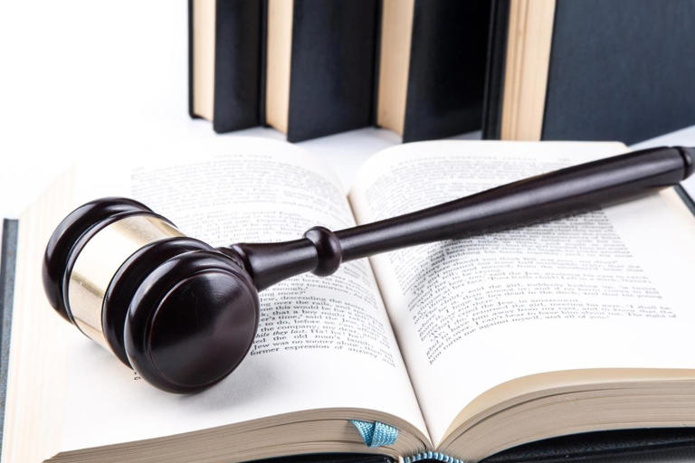
04. Access to Justice & Forensic Remedies
Guaranteed Investigative Timelines
The law establishes a specialized reporting node ensuring
that citizen-filed complaints receive an active response
and case number assignment within 72 hours.
Forensic Evidence Standard
To ensure a fair investigation and maintain the presumption
of innocence, digital evidence (packet captures, logs, disk
images) must adhere to rigorous, tamper-proof chain of
custody protocols before introduction in tribunals.

Slide 8
05. Criminal Penalties & Custodial Terms
Statutory Crime Definition | Minimum Term | Maximum Term | Financial Forfeiture
Unauthorized Intrusion / Access | 6 Months | 3 Years | 50,000 VIT Credits
Data Exfiltration & Theft | 5 Years | 8 Years | 250,000 VIT Credits
Ransomware Execution | 8 Years | 12 Years | 500,000 VIT Credits
Targeted Cyberbullying & Doxxing | 3 Months | 2 Years | 30,000 VIT Credits

Slide 9

06. Cyber Terrorism Clauses
🚩Aggressive Penalty Matrix
Attacking critical sovereign grids, telecommunication hubs,
or administrative command structures to destabilize public
safety is prosecuted under Cyber Terrorism guidelines.
Sentencing Floor: Minimum mandatory 15 years
imprisonment.
Sentencing Ceiling: Up to 25 years inside high-security
facilities.
Economic Penalty: Flat 2,000,000 VIT Credits forfeiture.

Slide 10
07. Statutory Aggravating factors
+50%
Compounded Sentencing scale
Judges apply an automatic 50% escalation to incarceration and financial penalties under four aggravating circumstances:
→The assault deliberately targets primary emergency medical care networks.
→The incident scales to disrupt or compromise > 10,000 unique identities.
→The operation is run by an organized or state-sponsored group.
→The individual has a previous cybercrime conviction.

Slide 11
08. The Data Protection Sub-Framework
Collection Proportionality
Entities can only collect minimal dataset fields directly relevant to operation. Unrelated processing triggers compliance violations.
Mandatory Erasure Protocols
Upon invocation of user erasure rights, systems must completely delete records from active caches and cold archives within 30 days..
System Architecture Auditing
Preventing financial fraud that undermines the digital economy and investor confidence
72-Hour Incident Accountability
Building public confidence in e governance through guaranteed privacy and rapid recovery protocols

Slide 12

09. Statutory Archival Persistence Limits
To protect personal data from perpetual corporateexposure, the law establishes strict retention caps
across all storage layers.
5 Years Maximum
General user engagement histories and analytical
activity tracking must be completely purged 5
years post-account closure.
7 Years Maximum
Core financial receipts and fiscal ledger
interactions can be retained for a maximum of 7
years to facilitate historical tax auditing.

Slide 13
10. Enterprise Corporate Governance
Any corporate entity operating commercially inside VIT's Republic must establish active organizational defenses:
DPO Appointment
Businesses handling profiles for >10,000 citizens
must appoint an independent Data Protection
Officer reporting directly to the board.
Mandatory Staff Training
Annual enterprise-wide security training simulations
are legally required to reduce internal corporate
vulnerability to social engineering.
Penetration Testing
Active red-team penetration verification must be performed annually against all critical production endpoints to validate defense integrity.

Slide 14

11. State Infrastructure & IoT Hardening
Oversight spans grid networks, aviation controls, and water facilities.
Air gapping mandate
Absolute physical/logical separation between
industrial control systems (ICS/SCADA) and public
systems.
IOT Hardware rules
Mandatory lifetime security patches; immediate
market ban on appliances distributed with
hardcoded administrator root passwords.

Slide 15
11. State Infrastructure & IoT Hardening
Oversight spans grid networks, aviation controls, and water facilities.
Air gapping mandate
Absolute physical/logical separation between
industrial control systems (ICS/SCADA) and public
systems.
IOT Hardware rules
Mandatory lifetime security patches; immediate
market ban on appliances distributed with
hardcoded administrator root passwords.

Slide 16
12. Emerging Tech: AI & Deepfakes
Artificial Intelligence networks operating inside critical macroeconomic
sectors face clear statutory regulatory requirements.
The Human-in-the-Loop Imperative
Autonomous algorithmic termination or denial of essential services
without an explicit human review override channel is strictly
illegal. AI engines cannot issue final unreviewable citizen service exclusions.
Watermarking Requirements
Public distribution of AI-generated deepfakes must embed an
immutable, machine-readable digital watermark identifying it as
synthetic media.

Slide 17
13. Enforcement Architecture & Education
The National Cybersecurity Agency (NCSA)
Directly splits oversight into: National CERT (Ops), Policy & Legal Bureau
(Compliance), and International Coordination Bureau (Cross-border crime
treaties)..
Human Firewall Initiative
Integrates baseline network safety awareness modules into school
curriculums and secondary academic interactive lab hackathons.

Slide 18
14. Statutory Enforcement Roadmap
Months 0-6
NCSA Assembly & National CERT monitoring center deployment.
Months 12
Mandatory corporate DPO registration and compliance initialization.
Year 3
First wave of required external infrastructure architecture audits.
Year 5 Target
Complete baseline stabilization and reduction of successful intrusions.

Slide 19
THANK YOU
By establishing enforceable citizen rights, clear corporate obligations, and strict penalty frameworks, VIT’s Republic safeguards its future digital landscape.

